Slide 1
Ames Housing Prices Prediction

Slide 2
Problem Statement
There are oftentimes mismatch of expectations between homeowners and home buyers. Homeowners look to maximize on the value of their house and home buyers look to get the best features on a tight budget. This project aims to answer some of these questions:
Homeowners
How can homeowners maximize the value on their house?
What are the features that add the most value to the house?
Homebuyers
What kind of house or features would homebuyers be able to afford based on their budget?
How much should buyers be paying for houses with certain features?

Slide 3
Workflow
EDA
Feature Engineering
Final Model testing
Data Cleaning
Modelling and Feature Selection

Slide 4
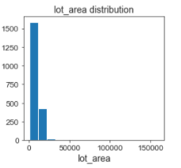
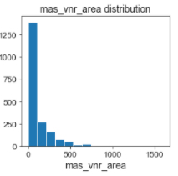
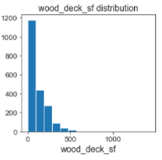
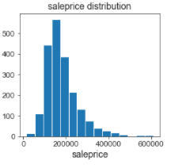
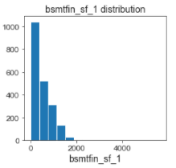
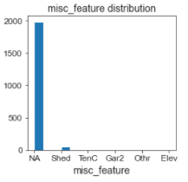
Skewness
Some features were observed to be heavily skewed.
Sale Price was also observed to be right skewed.

Slide 5
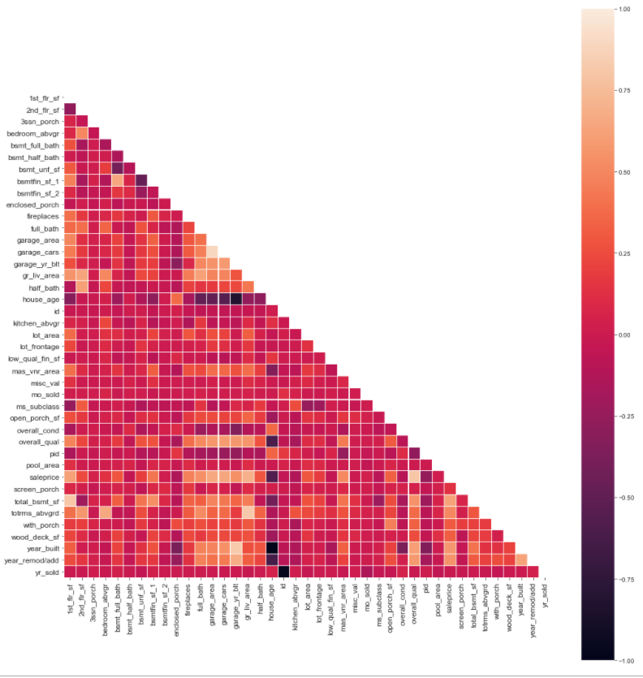
Collinearity
Some level of collinearity were observed between the features eg. number of garage cars and garage area.

Slide 6
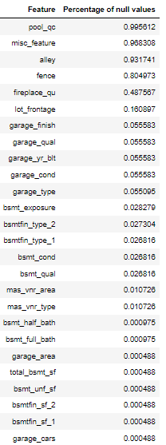
Null values
Some features observed to have high percentage of null values.
A null value in the corresponding feature likely indicates absence of the feature eg. lack of pool, lack of alley

Slide 7
Data Cleaning / Feature Engineering
Data Cleaning
Null values : Imputed to ‘0’, or ‘NA’.
Removing of outliers
Feature Engineering
Dropped columns with high single value counts and high collinearity
Created columns by combining features of the same category eg. ‘with_porch’ to indicate presence of porch
Converted ordinal data to numerical
Log transformed features with high skewness
Scaling of features due to unequal scales

Slide 8
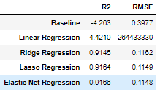
Model Performance
Elastic net was selected for the highest R2 score and the lowest RMSE.

Slide 9
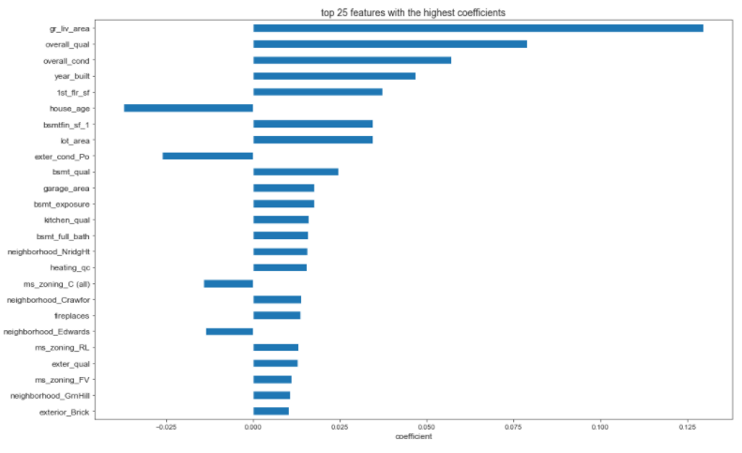
Final features
From the most important features, we see that many are related to area, quality and location of the house.
The older the house and the poorer the condition, the more the sale price of the house decreases.

Slide 10
Recommendations
Square feet living area, location and quality of the house are deemed the most important factors in deciding house prices
House buyers should look to purchase property in Northridge Heights, Crawford but not Edwards.
To maximize the sale price, house owners looking to sell their property should do it sooner rather than later.
People looking to sell should do it sooner rather than later
To increase the value of a home:
Repaint/remodel the interior and exterior finish
Renovate the kitchen
Add a fireplace and full bath (if not already present)
Renovate the house if it had been severely damaged

